Slide 1
Exercise 6: Agile: Initial Architecture

Slide 2
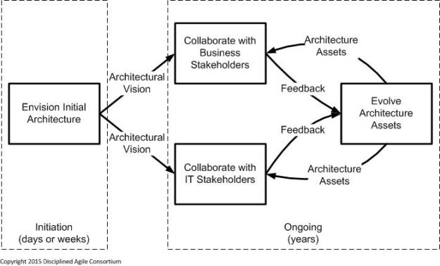
So what do we mean by “…Initial Architecture…”?
Identify high-level scope
Identify initial requirements
Identify and architecture vision
Design Thinking / Scoping Workshops
2-3 days
Project Initiation / Feasibility / Sprint 0
1 – 2 weeks
Initial Requirements
Initial Architecture
Architecture-on-a-page with annotations

Slide 3
Exercise 6: Agile – architecture-on-a-page
During this exercise we want you to create a complete two viewpoints in line with recommendations on “initial architecture’:
Architecture-on-a-page
Initial Security Viewpoint
Use:
ATW Case Study Background
Examples from the lecture materials
Ensure all critical elements are covered
Be ready with:
Two viewpoints from initial architecture
Use PowerPoint to document your viewpoints

Slide 4
THANK YOU

